Slide 1
P-Card Policies & Procedures Overview

Slide 2
What is a p-card
P-card stands for Purchasing card
Currently offering two types of cards
Travel and Expense (T&E) Card
Procurement Card
A P-card is a University issued credit card that is the preferred method of payment for expenses related to University business
It provides the cardholder with an efficient way to make purchases on behalf of the University without having to use his/her own funds
It provides the University with a cost-effective way to pay bills
The University receives rebates from the bank depending on the annual P-card spend

Slide 3
General Uses for P-Card
Subscriptions
Registrations
Retail stores
Grocery stores
FedEx
University Travel
Hotel and Airfare
Travel Meals
On Campus Vendors
LMU Bookstore
Sodexo
LMU Preferred vendors
Sparkletts
Payment for invoices to vendors who accept a credit card

Slide 4
Eligibility and Process
Complete and sign the P-Card Application
Must be an LMU or LLS employee.
P-Card application approved by supervisor
Review and Complete P-card Online Training
Approx. 1 week to receive card after it has been ordered.
Overnight processing is available for a $25.00 fee.
Complete P-card application form.
Applicant must be approved by the employee's supervisor and submitted to the Controller's Office.
Complete Training to receive card.
Sign P-card agreement form when P-Card is received
P-card agreement must be signed when card is receive.
In compliance with P-card policy
Compliance with P-card policy must be maintained for continual P-card use.

Slide 5
Facts about the card
The P-card is a Visa platform
Provided by J.P. Morgan Chase
Monthly Billing Cycle
Transaction details may be viewed and reconciled in Workday
Cards are issued in the employee's name but only the University is liable for the payment
Corporate Liability

Slide 6
The Card
Used just like any other credit card
Requires activation
Must be signed
Carries spending limits which are customized to each cardholder's budget responsibilities
Single transaction limit – Default $1,500
Monthly Spending limit – Default $20,000
Number of transactions per day limit – 12
Under no circumstances should a cardholder split transactions to circumvent their spending limit
Should a temporary or permanent increase in the spending limits be required, the cardholder's supervisor should email the P-card Coordinator and/or P-card Administrator with the request
In case of an emergency for immediate limit increase, call (310) 338-2714 so that a Program Administrator may be reached

Slide 7
Card Activation
Call the number on the back of your card to activate
Information needed to validate the cardholder could include one of the following:
Complete card number
Business phone number
Date of birth
Last four digits of your social security number
The address for the card is:
Loyola Marymount University
1 LMU Drive, Los Angeles, CA 90045 (LMU)
Loyola Law School
919 Albany Street, Los Angeles, CA 90015 (LLS)

Slide 8
Traveling Abroad
J.P. Morgan Chase needs to be informed about the cities and countries you will be visiting along with the dates that you will be traveling
This is to make sure that your P-card is not declined for charges in the foreign country
J.P. Morgan Chase can be contacted at (800) 270-7760
The contact number for J.P. Morgan Chase is also located on the back of the P-card

Slide 9
Personal Use on p-card
No personal charges are allowed on the P-Card
Failure to comply with the policy and procedures herein will result in suspension or termination of P-Card privileges and may result in disciplinary action
All transactions are to be submitted with proper documentation
Deposit the funds with the University Cashier and attach a copy of the deposit slip. Please input Workday Worktags. Mark the transaction personal in Workday, and use expense item/spend category “Personal on credit card” when reconciling the transaction.

Slide 10
Cardholder responsibilities
Do's
Get pre-approval for purchases according to department policy
Save receipts and invoices to attach to your monthly reconcilement
Don'ts
Make personal charges with your P-Card
Split transactions to circumvent card limits
Use your P-card to add funds to your One Card
Security
Card and card number must only be used by the cardholder
Secure the card at all times, just as you would your own
If the card is stolen, contact a P-card Administrator immediately or the bank if after hours

Slide 11
Cardholder responsibilities: Fraudulent charges & disputes
Notify bank immediately if card is lost or stolen
1
Immediately contact J.P. Morgan chase for any suspicious transactions.
2
All disputes are to be made within 60 days of transaction date
3
If duplicate charge, contact vendor first to resolve
4
Contact merchant when purchased items are defective or incorrect
5
Collect receipts to document for any credits
6
Do not give out PIN, cover while in use especially during international travel
7

Slide 12
Cardholder responsibilities: review of transactions
All P-card charges must be submitted monthly on an Expense Report
Each charge requires a general ledger account and a business purpose to be documented
All P-card charges $25 and over require a receipt to be provided
Cardholders must submit their previous month transactions by the 10th of each month
Failure to submit transactions on a timely basis may result in P-card privileges to be revoked

Slide 13
Cardholder responsibilities: Documentation and Support
Documentation / Support should include
Examples of Documentation
Vendor Name
Contact Information
Transaction date
Detailed list of items purchased
Dollar Amount for each item
Subtotal and Total of all items purchased
Sales Tax
Company invoice
Itemized store receipt
Itemized packing slip
Detailed work order (for repairs and services)
Federal express airway bill
Copies of subscription, registration, and dues form (filled out)
Email orders, acknowledgments or confirmations

Slide 14
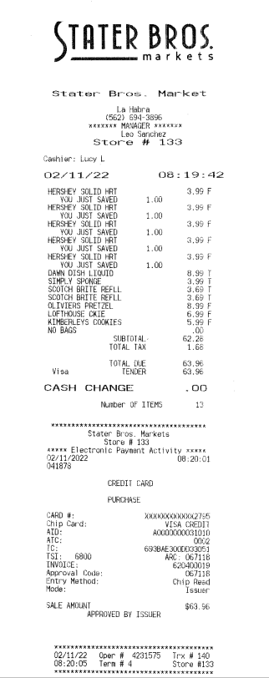
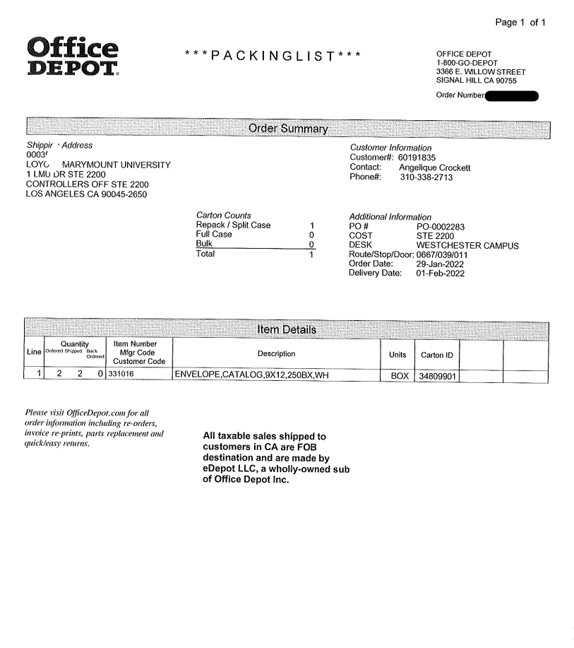
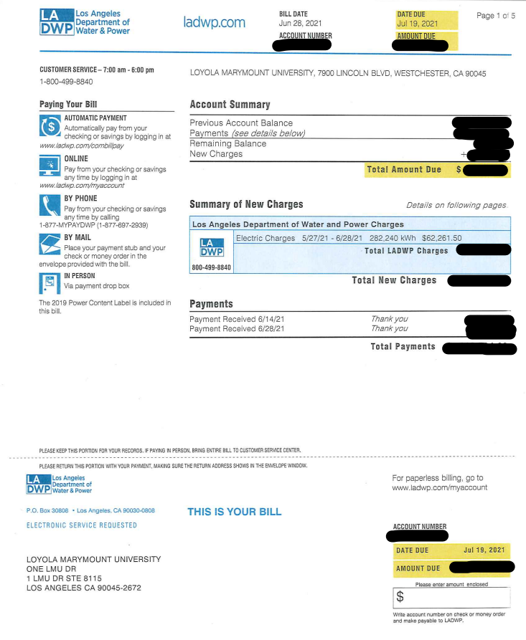
Receipt
Packing List
Invoice

Slide 15
Approver Responsibilities
Approvers should approve all transactions via Workday
Ensure charges were made for legitimate business purposes, Worktags account coding is correct, and the charges are properly supported
Once this review is complete, the approver must mark the transaction as approved through Workday
It is recommended that approvals for previous month transactions be done by the 15th of the following month

Slide 16
Links and forms
P-Card Policy
Purchasing & Payment Policy
Travel Policy
Identify Theft Policy

Slide 17
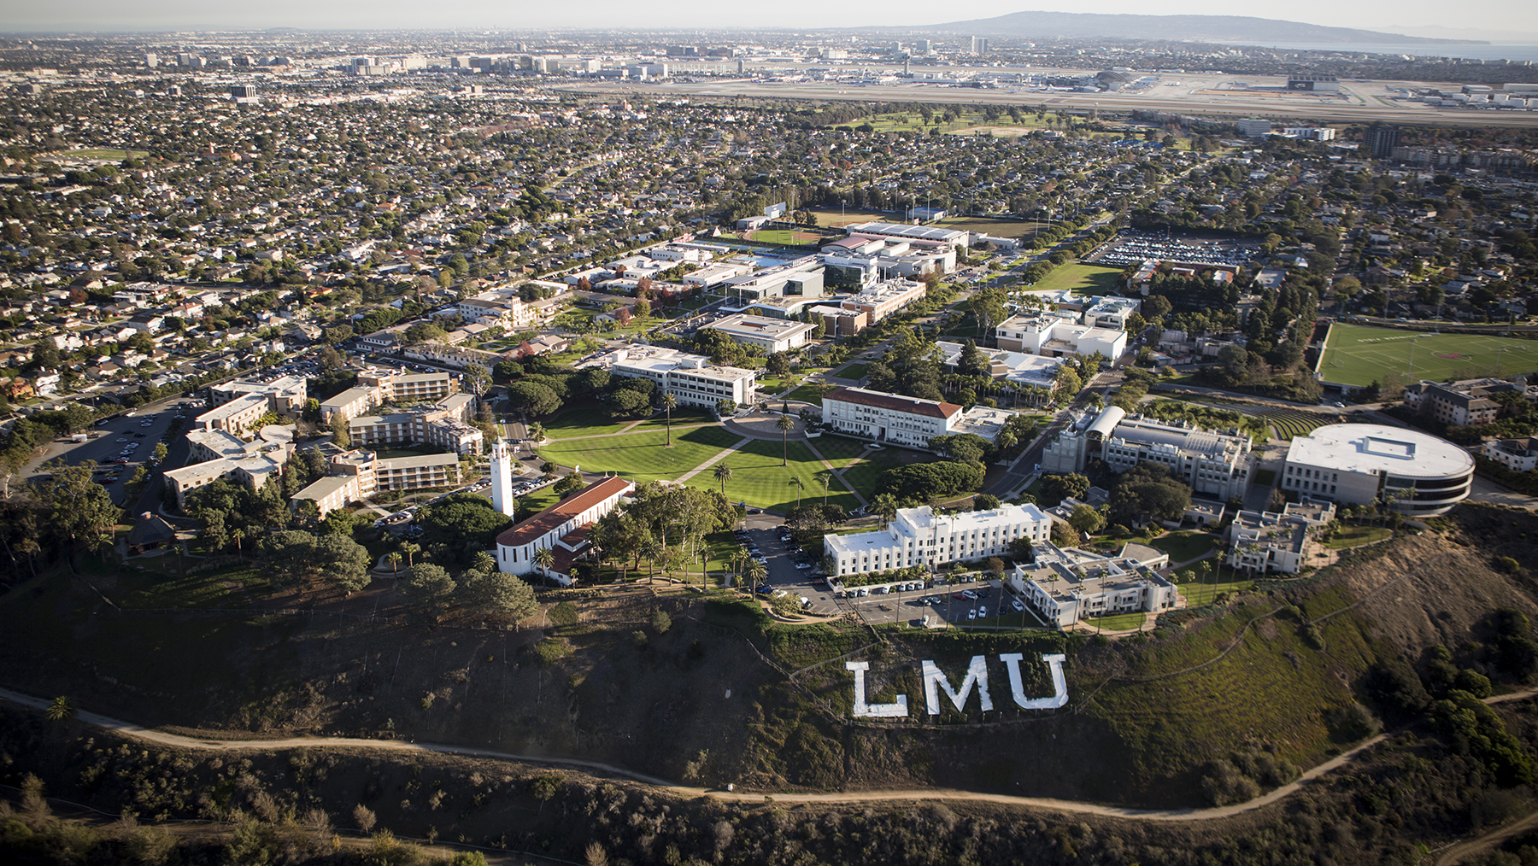
LMU credit card overview
T&E cards and procurement cards

Slide 18
LMu issued cards
Travel and Expense Card (aka T&E Card)
Procurement Card
A charge card issued to an individual for the purposes of making authorized purchases on the University's behalf. Card is primarily used for travel expenses and low dollar expense purchases
A charge card issued to an individual for the purpose of making authorized purchases on the University's behalf. Card is primarily used for payment of invoices for goods and services

Slide 19
Travel and expenses (T&E)
White
Previous P-cards are now called T&E cards
No change is physical card
To be used for Travel and low dollar expenses
Limits are typically 20,000 monthly and 1,500 single
Loaded automatically to the Expense module
Transactions need to be reconciled on an Expense Report
Transactions cannot be tied to a Purchase Order or a Request

Slide 20
T&E Cardholders responsibilities
Obtaining necessary approvals before using the card
Providing appropriate documentation to support the charges on their card
Enter a valid business purpose for each transaction in accordance with the IRS Accountable Plan
Submitting their expense reports in a timely manner according to the deadlines established by the Controller's Office (Within 30 days of the charge and no less frequently than a month)
Cardholders are responsible for safeguarding the cards as if it were cash and must notify the bank immediately if the card is lost or stolen
Cardholders are responsible for follow-up with the bank and LMU staff to resolve disputed items. Disputes must be put in within 60 days of the transactions

Slide 21
Reconciling T&E transactions
T&E Card Transactions must be reconciled by completing an Expense report
Employees having a Department Finance Specialist role are able to create a report for another employee. No delegation is required

Slide 22
Procurement card
Black
New Procurement cards
New cards were issued to employees as needed
To be used to pay all invoices and larger dollar purchases
Limits are customizable and generally higher than the T&E cards
Loaded automatically to the Procurement side
Transactions can be reconciled as a group if the work tags are the same by verifying them
Transactions can be tied to a Purchase Order or a Request

Slide 23
Reconciling procurement card transactions
Procurement card transactions must be reconciled by verifying the transaction in the procurement module
Employees having a Department Finance Specialist role are able to verify transactions for another employee

Slide 24
Approver responsibilities
Reviewing purchases for propriety and accuracy and ensuring that the business purpose and required documentation are appropriate
Approvers must login to Workday and approve transactions of their direct reports or transactions charged to their account timely
Approvers must make sure that all purchases on the card are in accordance with University Policy
Approvers must confirm that appropriate account codes are used
Approvers are responsible for notifying the Program administrator of cardholders who are separating from the University. The LMU Purchasing Card Surrender Form should be completed and sign by the Approvers

Slide 25
Cardholder Agreement
The Cardholder Agreement form must be filled out and submitted to the Controllers Office before obtaining your card.

Slide 26
Reconciliation Guides
Travel and Expense Card
Procurement Card

Slide 27
Workday Support Resources
Within Workday
In-system instructions: Located at the top of certain tasks
Workday support application on Workday homepage contains reference guides for completing Workday tasks
Email : workday@lmu.edu
(Your request will be routed appropriately)
P-Card Online Quiz

