Slide 1
Student Organizations: Fiscal Affairs Policies & Procedures
Johanna Infanzon
Budget Manager, Fiscal Affairs

Slide 2
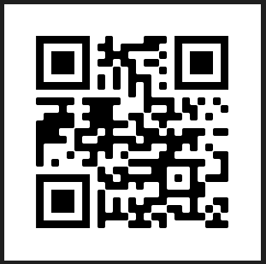
Presentation Available online
my.lls.edu/finance

Slide 3
Agenda
Account Balances
Deposits
Student Organization Revenue
Cash Transferring Applications
Expenses & Payments
Reimbursements
Receipts
Approvers
Reimbursements Workflow
Other Important Items
Fiscal Affairs Contact Information

Slide 4
Account Balances
What’s our Student Org. account balance?
Email Kristina Carrasco for account balances
For DSBA approved budget/balance, contact DSBA Treasurer
Who can request the account balance?
Presidents, Vice Presidents, and Treasures
It is the responsibility of the Student Org to keep track of all budgets and review and approve expenses.

Slide 5
Deposits
Checks should be deposited ASAP to avoid being lost or stolen
Deposit envelopes can be found outside the Cashier Office window
Founder Hall First Floor
Deposit receipts will be emailed to the individual depositing once processed

Slide 6
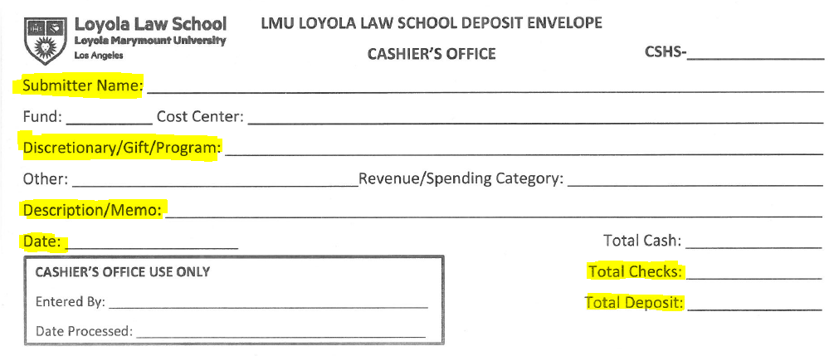

Slide 7
Student Organization Revenue
Membership Dues
Check
Credit/Debit Card: https://apps.lls.edu/online-payment/
Donations
Please contact Isabelle Sotomayor in Advancement for assistance in receiving donations.
Donation payments should NOT be processed using the above link.

Slide 8
Cash Transferring Applications
Cash transferring transactions and confirmations are NOT considered receipts or proof of payment
We cannot and will not reimburse out-of-pocket expenses paid by using cash transferring app confirmations
The following are a few examples of cash transferring apps:

Slide 9
Expenses & Payments
Student orgs pay for expenses out-of-pocket and are later reimbursed
Large Expenses (Big Ticket Items): Student Affairs can assist with payments
Examples: venue rentals, catering, sweatshirts, etc.
If payment assistance is needed, please contact the above as soon as possible
Not a payment option:
LLS Student Org credit card – there are NO Student Org credit cards on campus
LLS Cash advance – Cash advances for students are NOT allowed

Slide 10
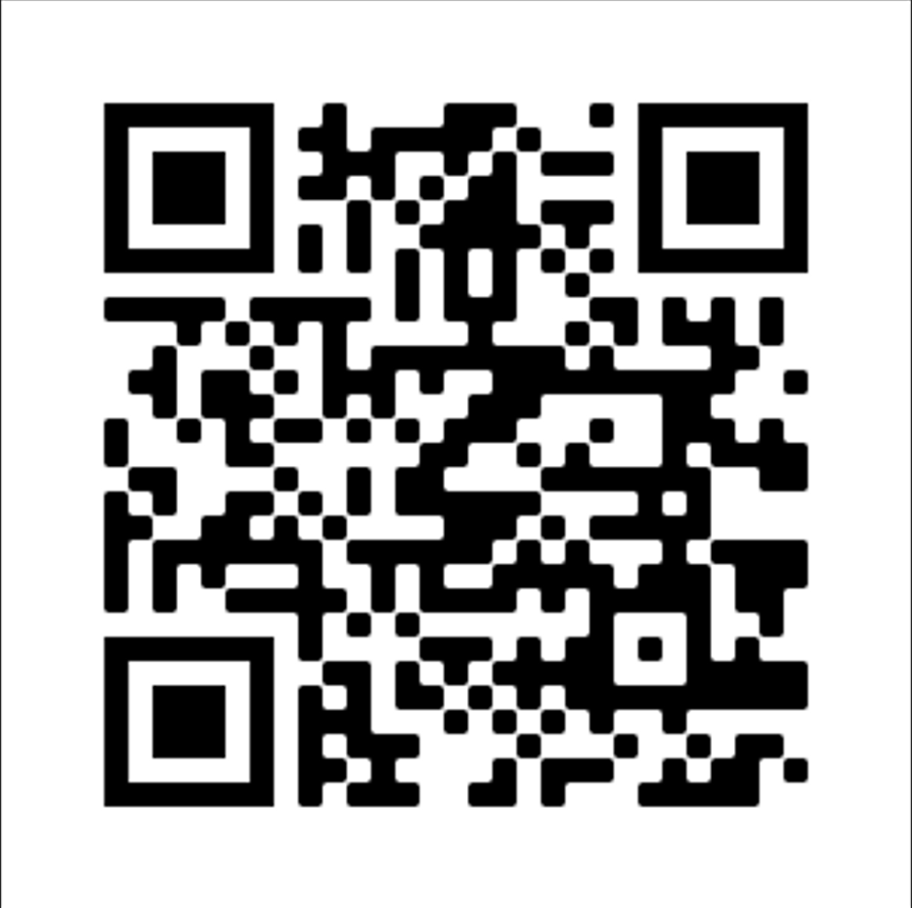
Reimbursements
Complete the online Student Reimbursement Request form
Attach image of original and itemized receipt/s
Mailing address must match PROWL.
students.lls.edu/finance-questions
It takes about 2 – 3 weeks to receive a check reimbursement from when Fiscal Affairs receives the request.

Slide 11
Receipts
Requirements:
Date
Vendor Name
Itemized (list item/s purchased)
Amount Paid
Payment Method / Proof of Payment
Cash, Credit Card (Last 4 digits), Check (back/front copy of cleared check)
If the payment is unclear we may ask for additional documentation such as a bank or credit card statement

Slide 12
Receipts
All out-of-pocket expenses must be submitted, approved, and paid within 60 days of the receipt date
Cash transferring app transactions and confirmations are not considered receipts or proof of payment
PLEASE DO NOT PAY VENDORS WITH VENMO OR ANY CASH APPLICATIONS

Slide 13
Approvers

Slide 14
Reimbursement Workflow

Slide 15
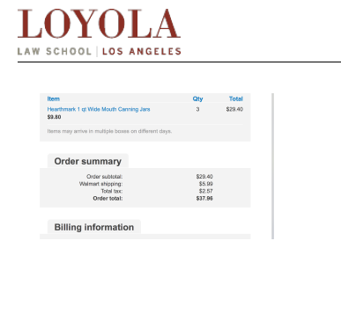
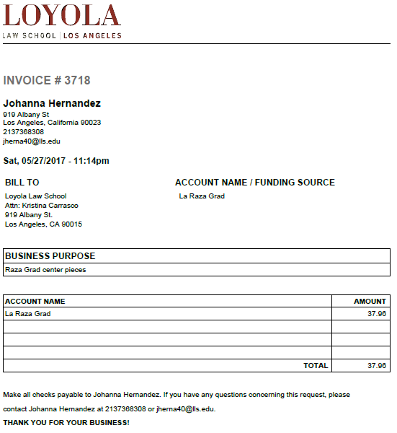

Slide 16
Other Important Items
Awards/Prizes/Gifts Informational Form
Completed form will be required for reimbursement
Recipient names are required
https://my.lls.edu/system/files/finance/awards_prizes_informational_form_2022.pdf
Alcohol - NOT a reimbursable expense
Unless pre-approved by Student Affairs
Logos
All logos should be pre-approved by Marketing & Communications Dept.
Payments for sweatshirts or mugs will not be processed without pre-approval.

Slide 17
Fiscal Affairs Contact Information
Johanna Infanzon, Budget Manager
Office: FH 124
Email: Johanna.Infanzon@lls.edu
Kristina Carrasco, Accounting Analyst
Office: FH 122
Email: Kristina.Carrasco@lls.edu

Slide 18
Any questions?
Thank you!

